Slide 1
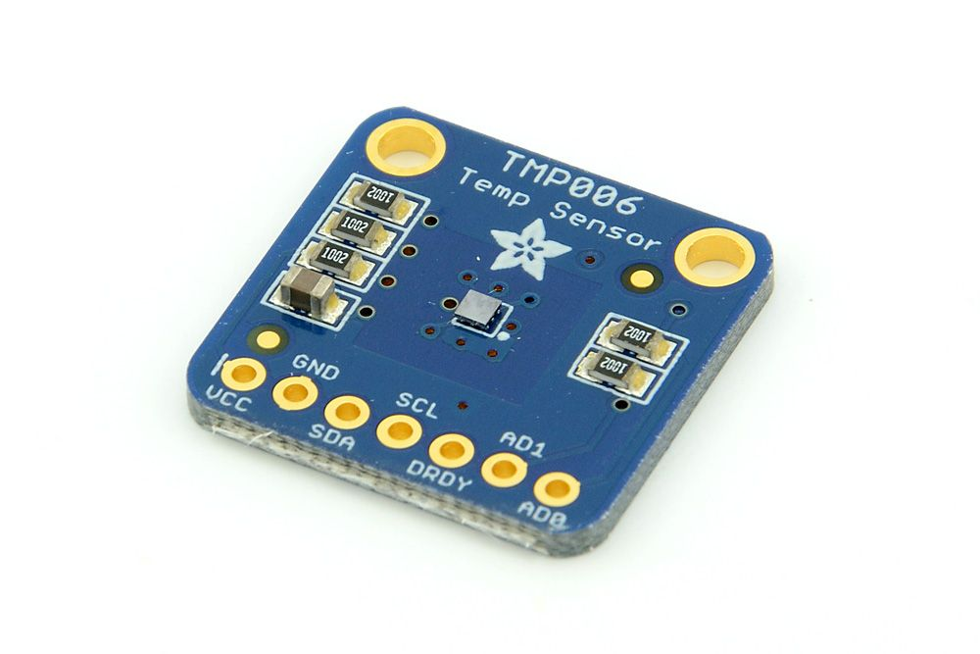
TMPoo6 IR Temperature Sensor
Malin Lomax
CENG317
11/27/2018

Slide 2
Proposal
TMPoo6 IR Temperature Sensor is a sensor that can measure the temperature of any object without making contact with it.
It detects and absorbs the infrared energy of an object regardless of how hot or cold it is.
The address that I am currently using this semester for my sensor is 0x46.
I plan on storing my temperature readings from my sensor to the Firebase database where all my data is stored.
My Proposal has changed I am now using the PCB to connect my sensor to Raspberry Pi 3 instead of jumper wires.

Slide 3

Budget
Raspberry Pi 3 $54.50
Power Supply $14.75
TMP006 IR Temperature Sensor $16.85
USB to Ethernet Adapter $17.99
SD Card w/ Adapter $12.99
Ethernet Cable $0.00
Total Cost $131.55
My Budget has not changed, I am still using the same materials for building my capstone project.

Slide 4
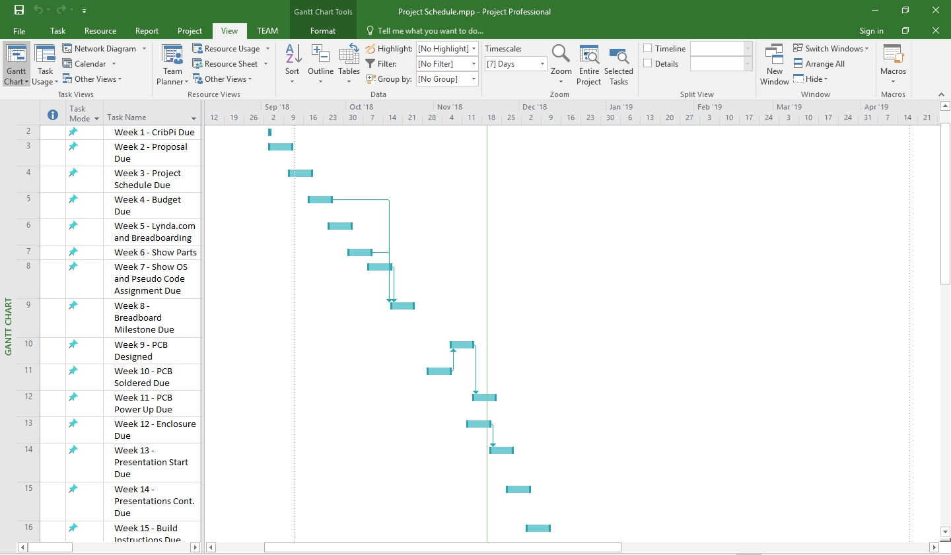
Schedule
Based on my project schedule I am on track because this week I am presenting my project and my hardware is completed on time for next semester.

Slide 5
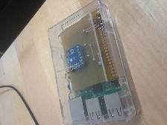
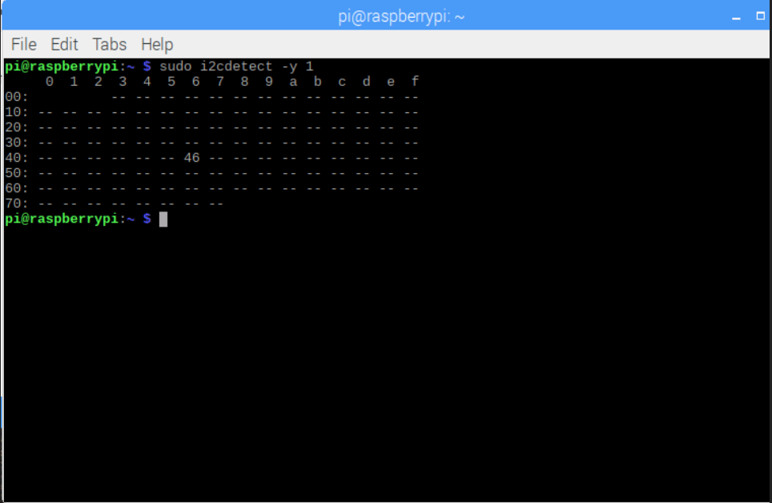
Final Hardware

Slide 6
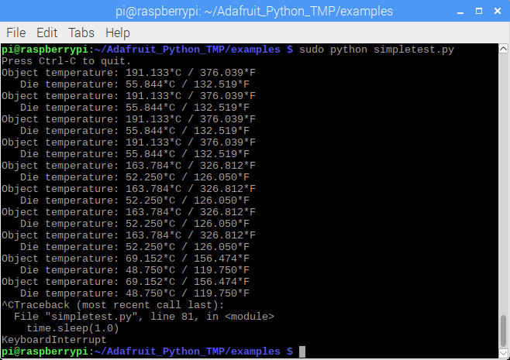
Reading Data from Sensor
The program I used was written in python to read data from my sensor and I sourced it from Adafruit. It reads data and prints out temperature readings from my sensor every second.
I changed the default constructor address to my sensor’s address in the python program from 0x40 to 0x46.
Object Temperature is the temperature data read from something that is hot right next to the sensor such as a person’s finger in both Celsius and Fahrenheit.
Die Temperature is the temperature data read from the sensor itself like how hot the chip is in Celsius and Fahrenheit.

Slide 7
Courses Applied in Project
CENG215 Digital Interface Systems – Introduction to Sensors. Building circuits and reading data from sensors.
CENG216 Software Engineering – Creating Gantt Charts to monitor the progress of individual activities.
CENG252 Embedded Systems – I2C, SDA, Microcontroller's, Creating Projects on Raspberry PI, etc.
WRIT220 Technical Workplace Writing Skills – Writing Progress Reports on blog to show updates on project.
TECH153 Technical C – Introduction to Raspberry Pi 3, UNIX, Remote Desktop Connection and making an LED on Raspberry Pi blink.

